Slide 1


Department of Artificial Intelligence and Machine Learning
AUTOMATED LEAF DISEASE DETECTION USING GAN WITH
TRANSFER LEARNING
IN MULTIPLE CROPS
By batch -2
M.Nirupama (21K61A6140)
T.Yamini (21K61A6159)
Batch ID:21K61A002
Project Guide:P.Sheela mam
P.Markandeyulu (21K61A6144)
Domain: Deep Learning
M.Mohan (22K65A6102)

Slide 2
ABSTRACT:
Agriculture is extremely important in human life. Almost 60% of the population is engaged in some kind of agriculture, either directly or indirectly.
There are no technologies in the traditional system to detect diseases in various crops in an agricultural environment, which is why farmers are not interested in increasing their agricultural productivity day by day.
Crop diseases have an impact on the growth of their respective species, so early detection is critical. Many Machine Learning (ML) models have been used to detect and classify crop diseases, but with recent advances in a subset of ML, Deep Learning (DL), this area of research appears to have a lot of promise in terms of improved accuracy.
The proposed method uses a convolutional neural network and a Deep Neural Network to identify and recognise crop disease symptoms effectively and accurately. Furthermore, multiple efficiency metrics are used to assess these strategies.
This article offers a thorough description of the DL models that are used to visualise crop diseases. Furthermore, several research gaps are identified from which greater transparency for detecting diseases in plants can be obtained, even before symptoms occur. The proposed methodology aims to develop a GAN with transfer learning method for detecting plant leaf disease

Slide 3
INTRODUCTION:
India is a rapidly developing nation, and agriculture is the backbone of the country's early growth. Agriculture is struggling to meet its needs as the global population grows at a rapid rate.
Furthermore, knowledge of the importance of cultivation must be instilled in the minds of the younger generation. Climate change, pollinator decline, crop pests, lack of irrigation, and other factors continue to pose a threat to food security. Crop disease reduces both the quantity and quality of food produced.
Crop diseases not only has an effect on global food security, but they also have a negative impact on small-scale farmers whose livelihood is dependent on safe cultivation. The benefit is that crop diseases can be monitored by detecting them as soon as they appear on the crops. It has been possible to provide an effective solution to this problem thanks to the advent of the internet and the field of computer vision.
A mistaken diagnosis of plant disease results in a significant loss of production, time, resources, and product quality. Identifying the state of the plant is critical for effective cultivation. Different types of environmental anomalies, such as fungi, water shortages, insects, and weeds, have an effect on crops. These are the kinds of issues that require farmers to take preventative steps in order to boost productivity.

Slide 4
LITERATURE SURVEY:
1. Overview (2020–2024):
Recent years have seen a surge in AI-based approaches for plant disease detection, aiming to reduce manual efforts and increase crop yield.
Focus has shifted towards deep learning techniques, especially Transfer Learning (TL) and Generative Adversarial Networks (GANs) for enhanced model performance and synthetic data generation.
2. Key Trends in Research:
Transfer Learning: Widely adopted with pre-trained models like VGG16, ResNet50, and EfficientNet to handle limited labeled datasets and improve accuracy across different crop types.
GANs for Data Augmentation: GANs (especially DCGAN, CycleGAN, and StyleGAN) are used to generate synthetic diseased leaf images, overcoming dataset imbalance and boosting model generalization.
Multi-Crop Analysis: Studies have expanded beyond single crop disease detection to multi-crop datasets (e.g., tomato, maize, grape, potato), enabling more generalized systems.
3. Notable Works:
2021: Researchers applied CycleGANs to generate synthetic images for rare disease classes, combined with ResNet50-based classifiers.
2022: Multi-class classification models using TL+GANs reported over 95% accuracy in detecting diseases in 5+ crop types.
2023–2024: Emergence of hybrid models combining TL, GAN, and attention mechanisms for finer feature extraction and disease localization.
4. Datasets Used:
PlantVillage, AI Challenger, and custom field datasets.
Synthetic data generation has helped alleviate overfitting issues in deep CNNs trained on small real-world datasets.
5. Research Gaps:
Need for more field-level validation, especially under varying lighting and background conditions.
Integration with IoT and edge devices for real-time detection is still limited.

Slide 5
MODULES:
Data Collection and Preprocessing
Model Definition
Training Process
Evaluation and Improvement

Slide 6
MODULE 1:
Data Collection:
The Dataset is collected by taking pictures of different type of crops like Sugarcane ,Tomato , Rice in which we include more than one crop species.
The dataset consists of 38 different classes of plants, with over 8000 images in total. Each image has been annotated with the species of the plant, making it a multi-class image classification problem. The images were collected from a variety of sources and were manually annotated to ensure accurate labelling. The dataset is commonly used as a benchmark for developing and evaluating computer vision models for leaf disease classification.
Data cleaning and handling missing values if necessary.

Slide 7
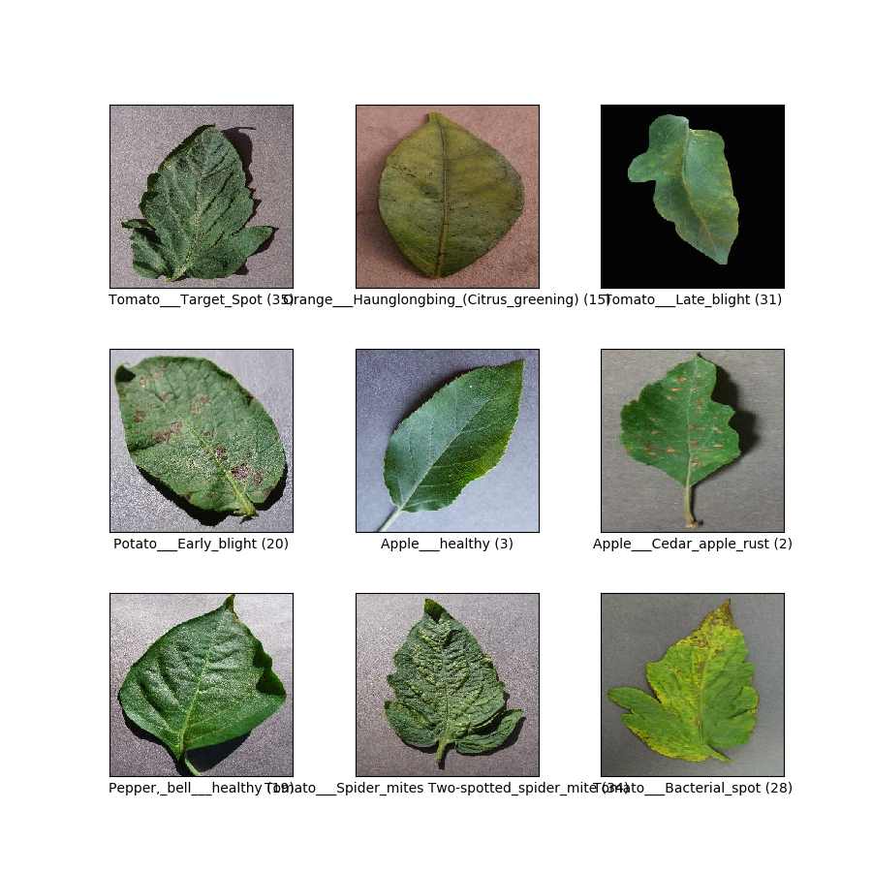
Contd:

Slide 8
Preprocessing:
Data augmentation is a technique used to artificially increase the size of the training dataset by transforming the existing images in various ways.
The argument shear_range=0.2 specifies the maximum amount of shearing to be applied to the images. Shearing is a transformation that slants the image along the x or y axis.
The argument zoom_range=0.2 specifies the maximum amount of zooming to be applied to the images. Zooming is a transformation that increases or decreases the size of the image.
The argument horizontal_flip=False and vertical_flip=False specify whether to flip the images horizontally or vertically, respectively.
The argument fill_mode='nearest' specifies the strategy to use for filling in newly created pixels, which may be introduced by the transformations.
The arguments width_shift_range=0.2 and height_shift_range=0.2 specify the maximum fraction of total width/height by which to translate the images horizontally/vertically, respectively.

Slide 9
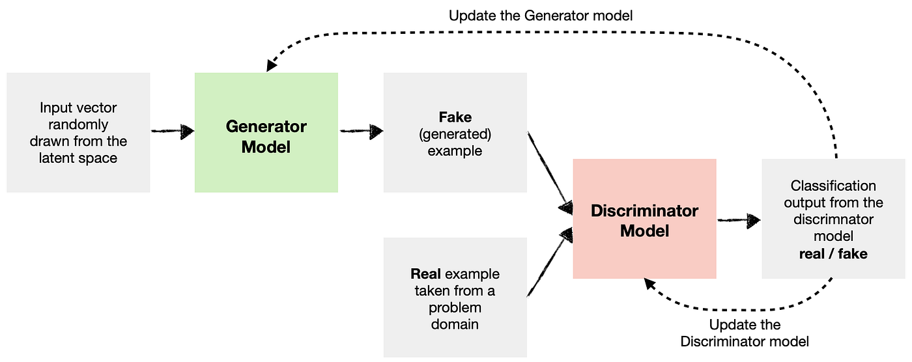
MODULE 2:
Model Definition:
Generator Network:
Architecture: Usually a convolutional neural network (CNN) with transposed convolution layers to upsample noise into desired data format.
Input: Random noise vector.
Output: Generated data (e.g., images, text).
Discriminator Network:
Architecture: Typically a CNN with convolution layers to extract features.
Input: Real or generated data.
Output: Probability score indicating whether the input is real or fake.

Slide 10
MODULE 3:
Training Process:
Loss Functions:
Discriminator Loss: Binary cross-entropy loss to classify real data as "real" and generated data as "fake".
Generator Loss: Binary cross-entropy loss to fool the discriminator by making generated data look "real".
Training Loop:
Generate Noise: Sample random noise for the generator.
Generate Fake Data: Feed the noise into the generator to produce fake data.
Discriminate: Feed both real and generated data to the discriminator to get classification results.
Update Discriminator: Update discriminator weights to better distinguish real and fake data based on the loss.
Update Generator: Update generator weights to produce more realistic data based on discriminator feedback.

Slide 11
MODULE 4:
Evaluation and Improvement:
Visual Evaluation:
Visualize generated samples to assess quality and diversity.
Quantitative Evaluation:
Inception Score (for image generation): Measures how well the generated images are spread across different classes.
Frechet Inception Distance (FID): Measures the similarity between the distribution of real and generated data.
Hyper parameter Tuning:
Adjust learning rate, batch size, network architectures, and other parameters to optimize GAN performance.

Slide 12
IMPLEMENTATION:
1. Dataset Loading
The dataset consists of leaf images from multiple crops such as tomato, potato, maize, and grape, categorized into healthy and diseased classes. These images are typically sourced from publicly available datasets like PlantVillage or custom field-collected datasets.
Images are preprocessed using transformations such as resizing, normalization, and augmentation (e.g., rotations, flips) to ensure uniform input size and enhance model generalization. The dataset is split into training, validation, and test sets.
2.GAN for Synthetic Image Generation (CGAN)
Conditional GAN (CGAN) is an extension of GAN where both the generator and discriminator are conditioned on class labels, enabling the generation of specific types of diseased leaf images (e.g., "maize-blight" or "tomato-septoria").
The CGAN model learns to generate realistic and labeled synthetic leaf images, which are then added to the training set to address class imbalance, especially for rare diseases.
By augmenting the dataset with labeled synthetic images, CGAN improves the diversity and balance of data available for training, enhancing the overall robustness and accuracy of the classification model.
3. Transfer Learning using a Pre-trained CNN (e.g., ResNet50)
A pre-trained model like ResNet50 is used for feature extraction. Transfer learning allows the model to leverage knowledge from large datasets (like ImageNet) and adapt it to the plant disease domain with fewer training samples.
The final classification layer of ResNet50 is replaced with a new fully connected layer matching the number of crop-disease classes. Only this final layer (and optionally the last few convolutional blocks) is fine-tuned during training to speed up convergence and improve accuracy.
4. Training and Evaluation
The model is trained using cross-entropy loss and an optimizer like Adam. Training involves multiple epochs where the model adjusts its weights to minimize classification error on the training data.
After training, performance is evaluated using accuracy, precision, recall, and F1-score on the validation/test dataset. Evaluation also includes visualizing confusion matrices and ROC curves to assess class-wise performance and overall effectiveness.

Slide 13
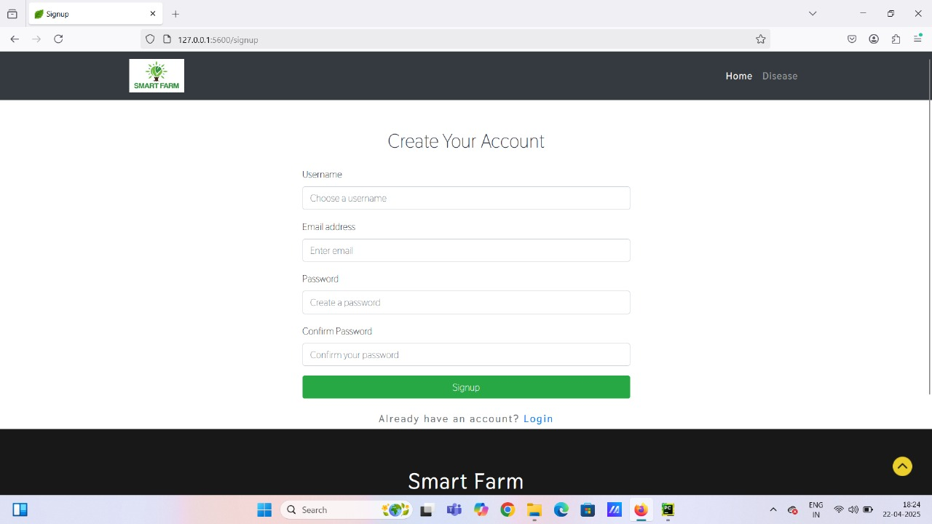
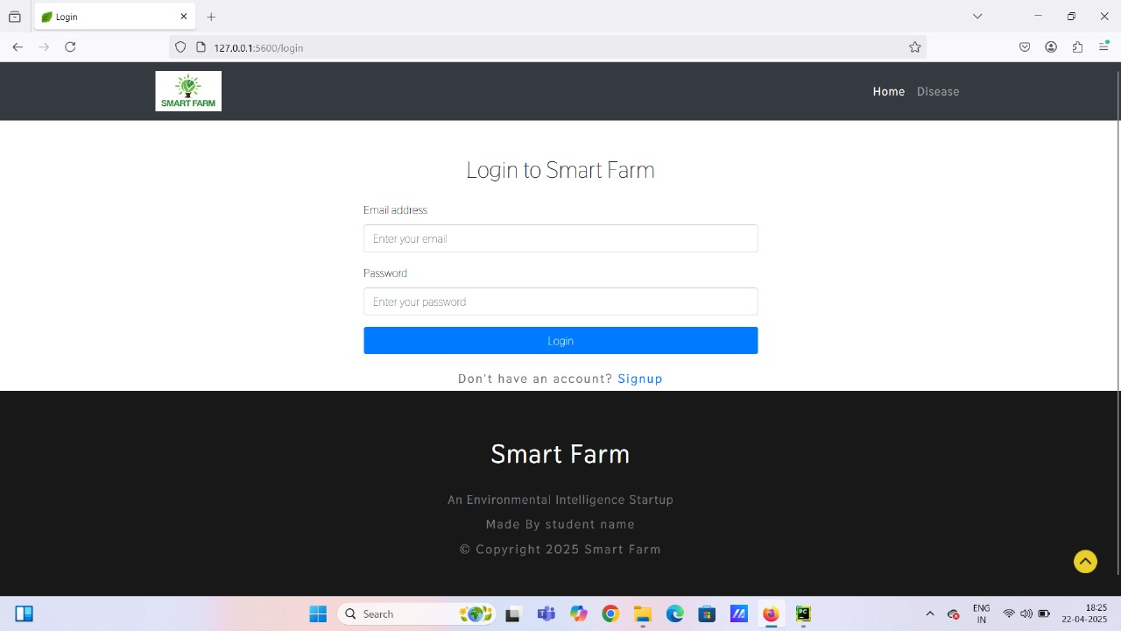
User -friendly dashboard (login page and Signup )

Slide 14
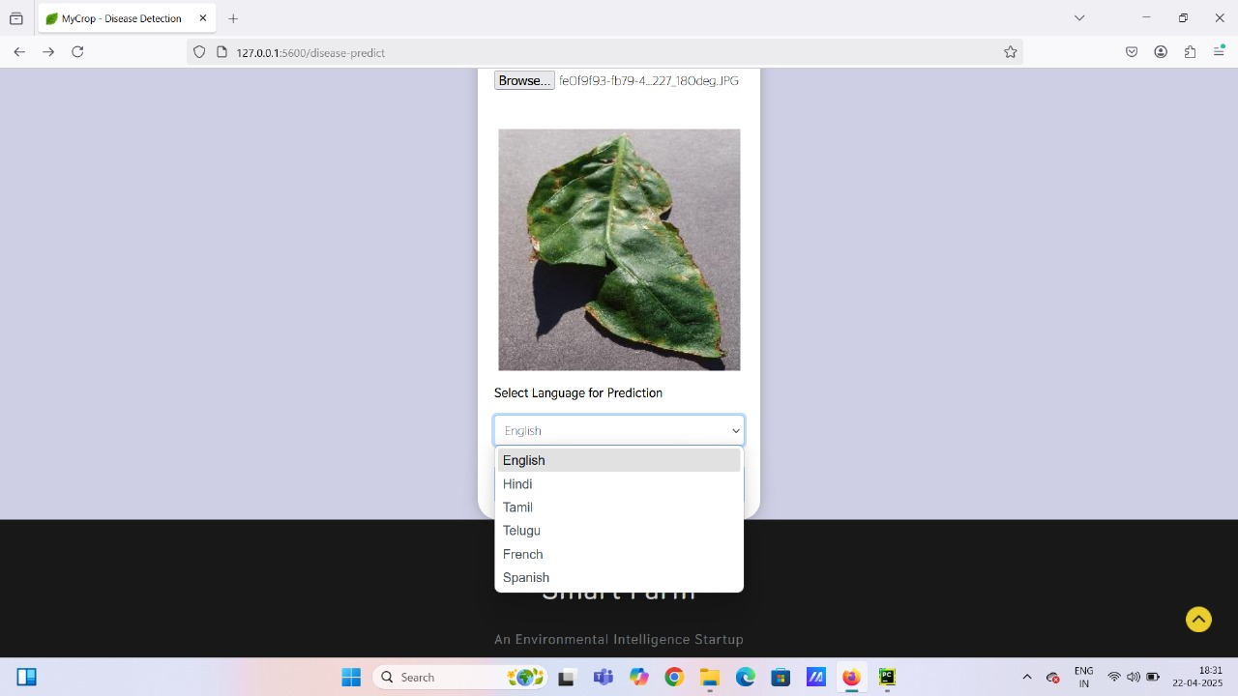
Language Selection:(Preferable language selection for the users)

Slide 15
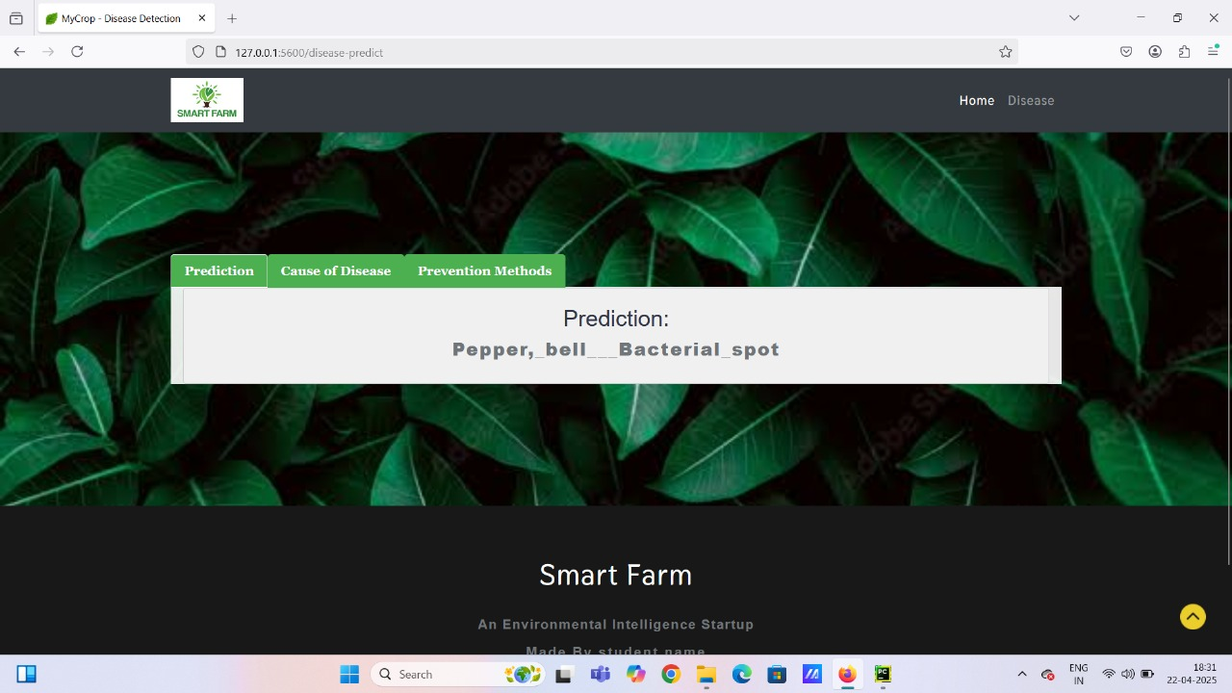
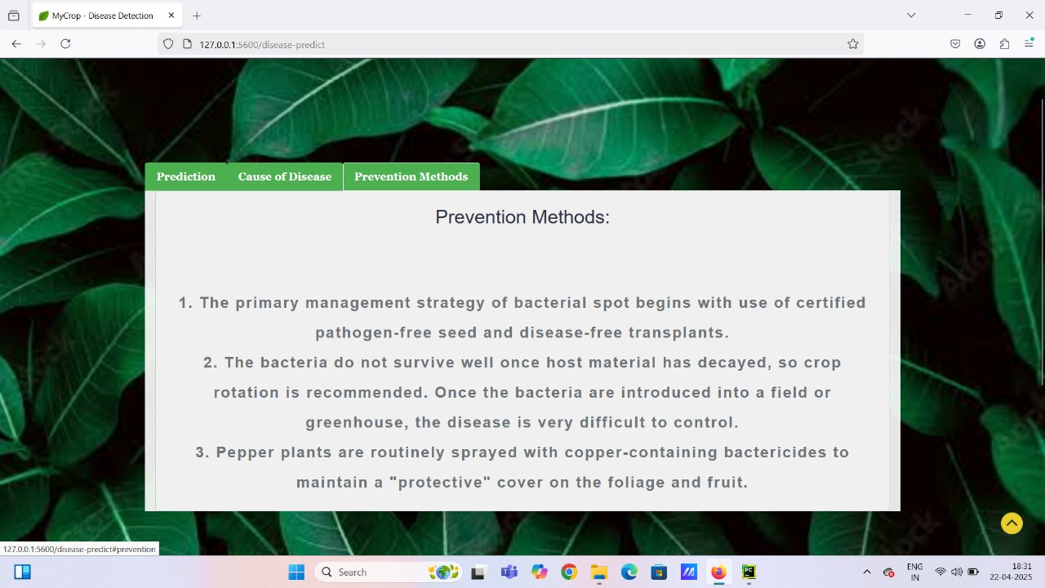
Prediction & Prediction Methods can be seen:

Slide 16

Cause of the disease can also be known:

Slide 17
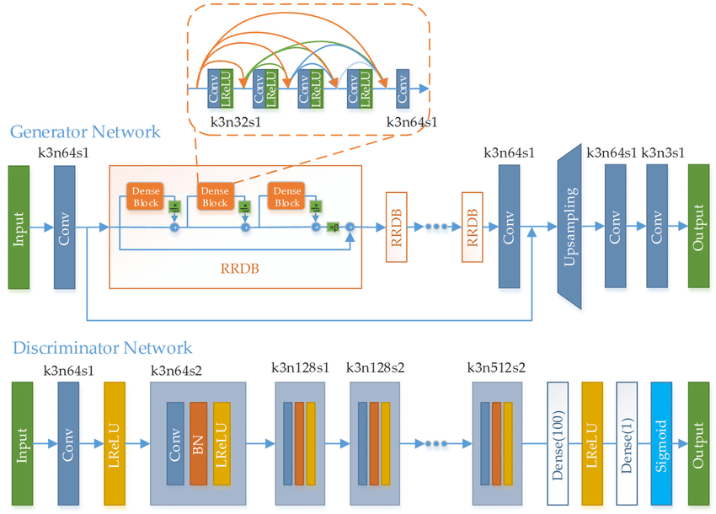
ADVANTAGES OF PROPOSED SYSTEM:
Enhanced Accuracy
Data Diversity
Reduced Overfitting
Efficient Disease Management
Proactive Solutions
Sustainable Agriculture

Slide 18
DISADVANTAGES OF EXISTING SYSTEM :
Vector quantization: Can cause information loss due to approximation.
Segmentation techniques: Sensitive to noise and image quality variations.
Wavelet transforms: Struggle with handling edges or rapid transitions.
Color quantization: Reduces visual quality and color accuracy.
SVM-based segmentation: Computationally intensive for large datasets.

Slide 19
Conference Submission Details:
•The 2nd International Conference on Algorithms and Computational
Theory for Engineering Applications(ICACTEA)
•- Paper ID: 184.(Title:Automated leaf disease detection using GAN
with multiple crops in transfer learning)

Slide 20


